Slide 1
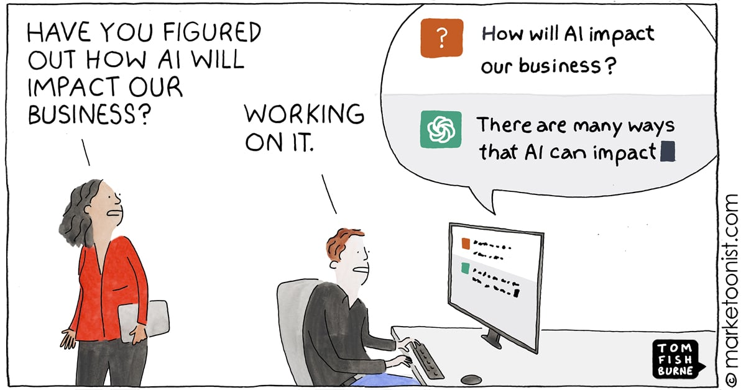

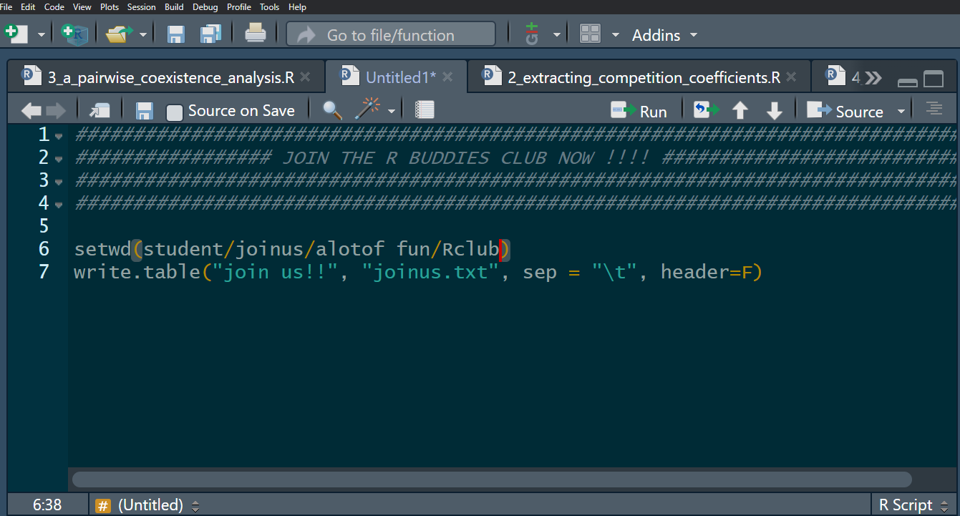

coding
Welcome to the…
CODING
Session 2:
~ How to choose your AI ~
By
Caroline Daniel,
Postdoc at the IEE
R
Buddies
Club

Slide 2

R club, program and milestones
Session 1: AI introduction and building a personal code of conduct for AI use (February)
Session 2: What type of AI is there? What’s their differences? (March)
Session 3: Building your own AI tool (April)
Session 4: Building your own AI tool (May)
Session 5: Assignment, producing a R script made with the help of your AI tool (June)

Slide 3
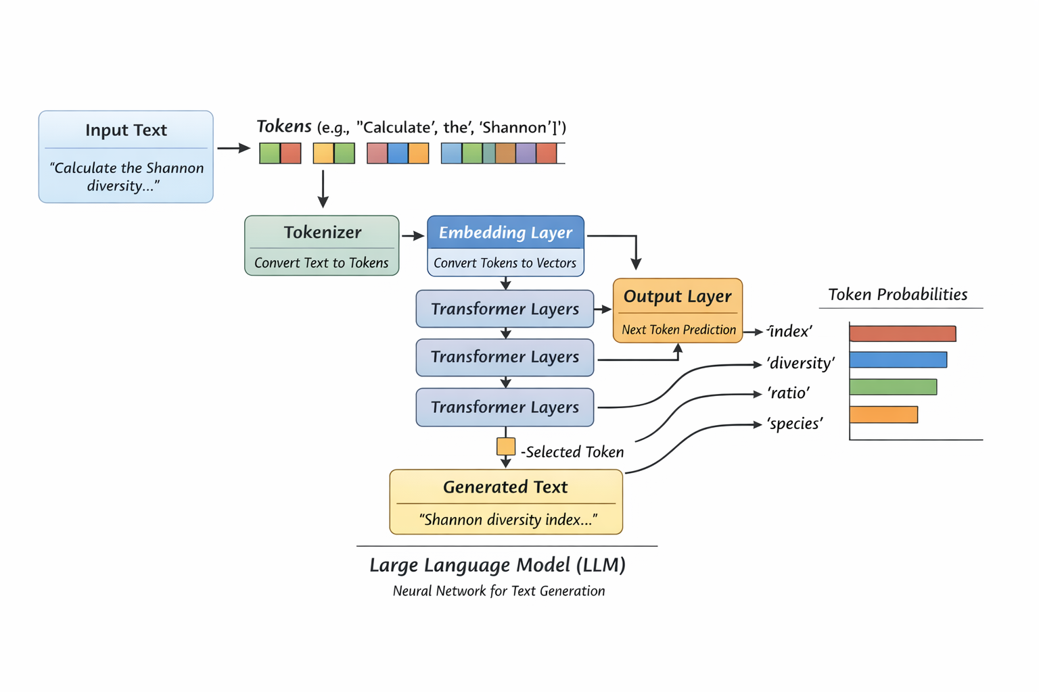
LLMs - how does it works?

Slide 4
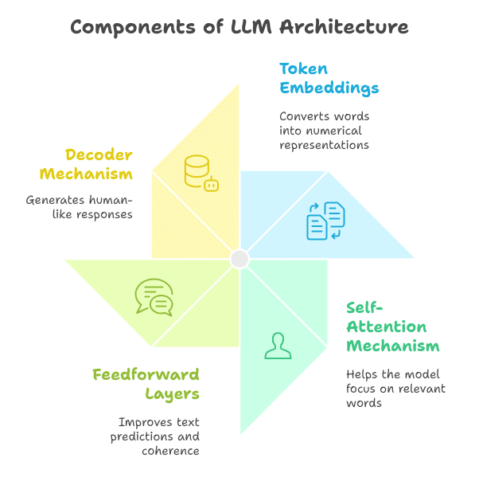
LLMs - how does it works?

Slide 5
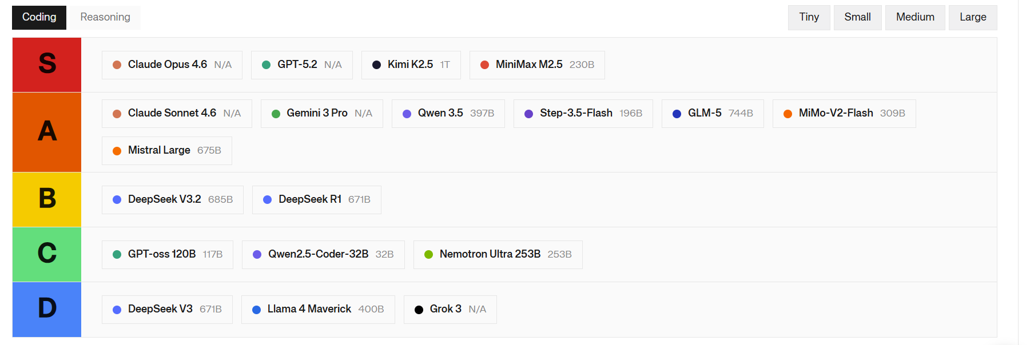
Who is the best coder?

Slide 6

Who is the best coder?
… bur for nearly all of these, you need to pay!

Slide 7
What are our free options?
1. Github Copilot

Slide 8
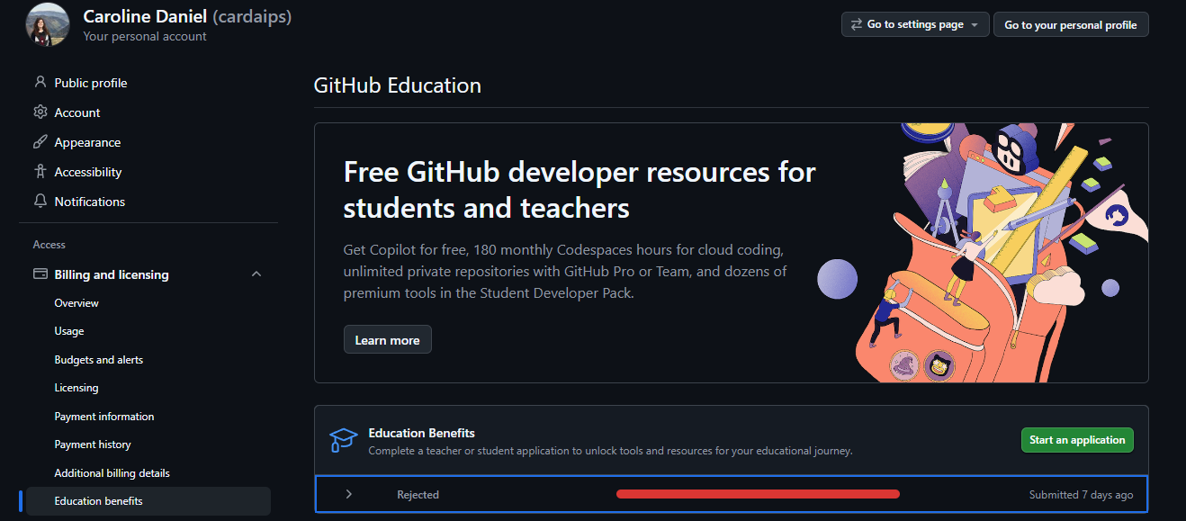
What are our free options?
1. Github Copilot

Slide 9
What are our free options?
1. Github Copilot

Slide 10
What are our free options?
1. Github Copilot
2. Local models

Slide 11
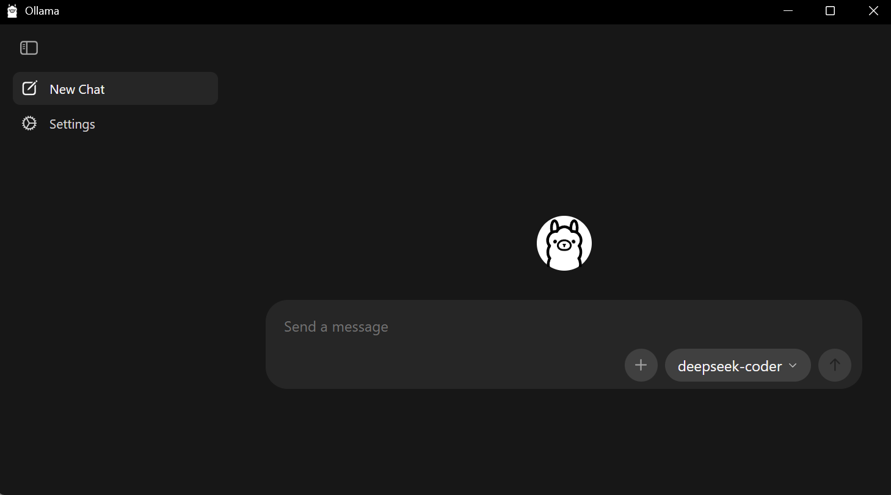
What are our free options?
1. Github Copilot
2. Local models
Step 1: install the interface

Slide 12
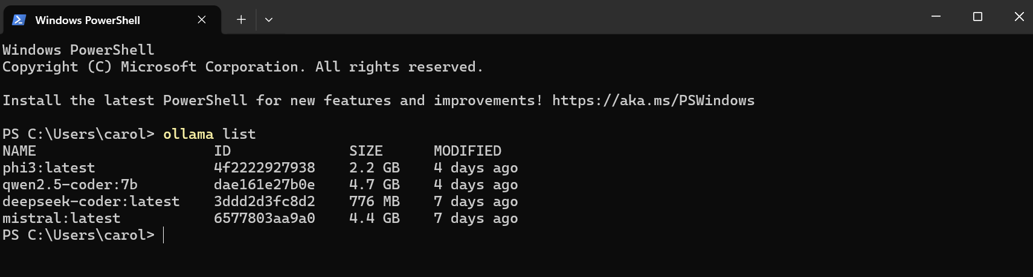
What are our free options?
1. Github Copilot
2. Local models
Step 2: pick your team of free models, one for each specific task

Slide 13
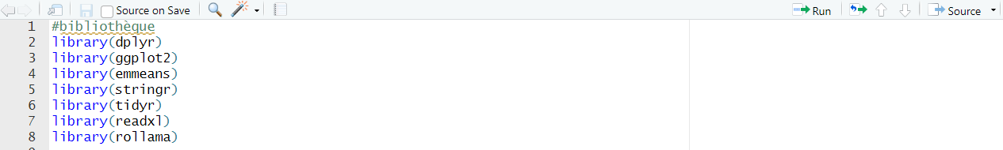
What are our free options?
1. Github Copilot
2. Local models
Step 3: embed it in R, with a nice package: make your queries directly in R and use functions to customise!

Slide 14
What are our free options?
1. Github Copilot
2. Local models
Step 3: embed it in R, with a nice package: make your queries directly in R and use functions to customise!

Slide 15
Conclusions
For now, we can still focus on one of the free options, but as progress will be made with LLMs, it may become difficult to ignore the price

Slide 16
Conclusions
For now, we can still focus on one of the free options, but as progress will be made with LLMs, it may become difficult to ignore the price
But some LLMs are made with the idea to be more open access and more transparent (like Mistral for example)

Slide 17
Conclusions
For now, we can still focus on one of the free options, but as progress will be made with LLMs, it may become difficult to ignore the price
But some LLMs are made with the idea to be more open access and more transparent (like Mistral for example)
I think we can aim to set up a “hybrid” LLM practice, where we use smaller models and targeted instructions 80% of the time, with a possible back-up from larger LLMs if necessary

Slide 18
Conclusions
For now, we can still focus on one of the free options, but as progress will be made with LLMs, it may become difficult to ignore the price
But some LLMs are made with the idea to be more open access and more transparent (like Mistral for example)
I think we can aim to set up a “hybrid” LLM practice, where we use smaller models and targeted instructions 80% of the time, with a possible back-up from larger LLMs if necessary
Most likely, as LLMs will become indispensable tools to productivity, they will become like a software that any workplace has to provide you with.

Slide 19


Your turn!

